Slide 1
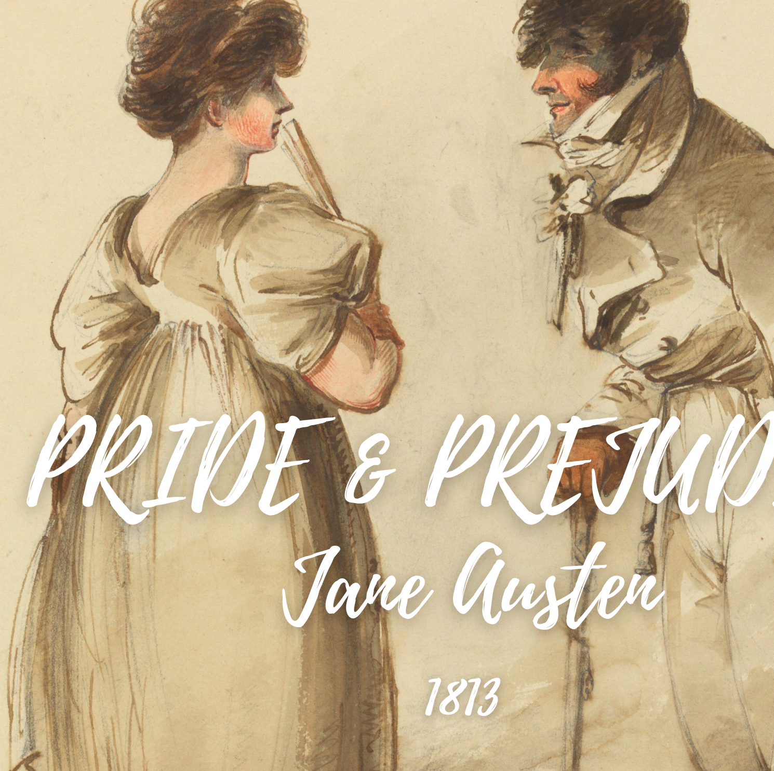
Analysing Texts using Python
Computer Science
Worksheet 2 – Word Frequencies
Slides created by Áine Rourke. Worksheets and Code by Dr. Derek Greene (under CC-BY-NC licence)

Slide 2
Start with the same code for the libraries, directories and read the book into a single string
Import your libraries
Point your program to the directory
Read the book in

Slide 3
1. Next we need to convert all letters to lowercase……why?
3. If there is more than one way of doing this try and pick the most efficient
2. How can you do this? Can your Python Reference sheet help with this?

Slide 4
We now need to work out what is words and what isn’t! We can split the text by whitespaces. Take a couple of minutes and research how we might do this!
Notes:
This searches for groups that have alphanumerics (that's the \w part) or apostrophes (which is also in those square brackets) that are 1 or longer. Whitespaces aren’t either of these so it gets split into words.

Slide 5
Now we want to find the most common words....how might we do this? Does python have anything inbuilt that might help? Take 5 minutes with a partner and investigate this!
Notes:
This searches for groups that have alphanumerics (that's the \w part) or apostrophes (which is also in those square brackets) that are 1 or longer. Whitespaces aren’t either of these so it gets split into words.

Slide 6
What type of words are you getting when you run the program? Make a quick list. Are they useful words?

Slide 7
So lets remove the small words……with less then 2 letters…..how do we do this?
Can your python reference sheet help here?

Slide 8
Stopwords………………….why do we need them??

Slide 9
How could we delete the stopwords from our list?

Slide 10
A list of words might not be the best way to represent this, so what could we use?
What did we use in the last worksheet?
Hint…..where do we keep lots of books?

Slide 11
Graphing using mathplotlib
Can you change the code to make this a normal bar chart? What about a pie chart?
What graph is easiest to read?
Change the layout....what colour would you like? Is the font big enough? Do you like the font?

Slide 12
Bonus Tasks……
Compare the 3 texts you have downloaded - use the same programs to analyse these.
Double Bonus Task……
Can you go to Project Gutenberg and download another book and analyse it? Think about the language of the book….what would you need to change?

Slide 13
The Novel Analytics Project materials are licensed under a Creative Commons Attribution-Non-Commercial 4.0 International License. You are free to adapt and remix the slides and worksheets provided you give credit to the creators and do not use them for commercial purposes. Permissions beyond the scope of this license may be available here.This work is licensed under a Creative Commons Attribution-NonCommercial 4.0 International License.
Slides Created by Áine Rourke. Worksheets and Code by Dr. Derek Greene. (under CC-BY-NC licence)

