Slide 1
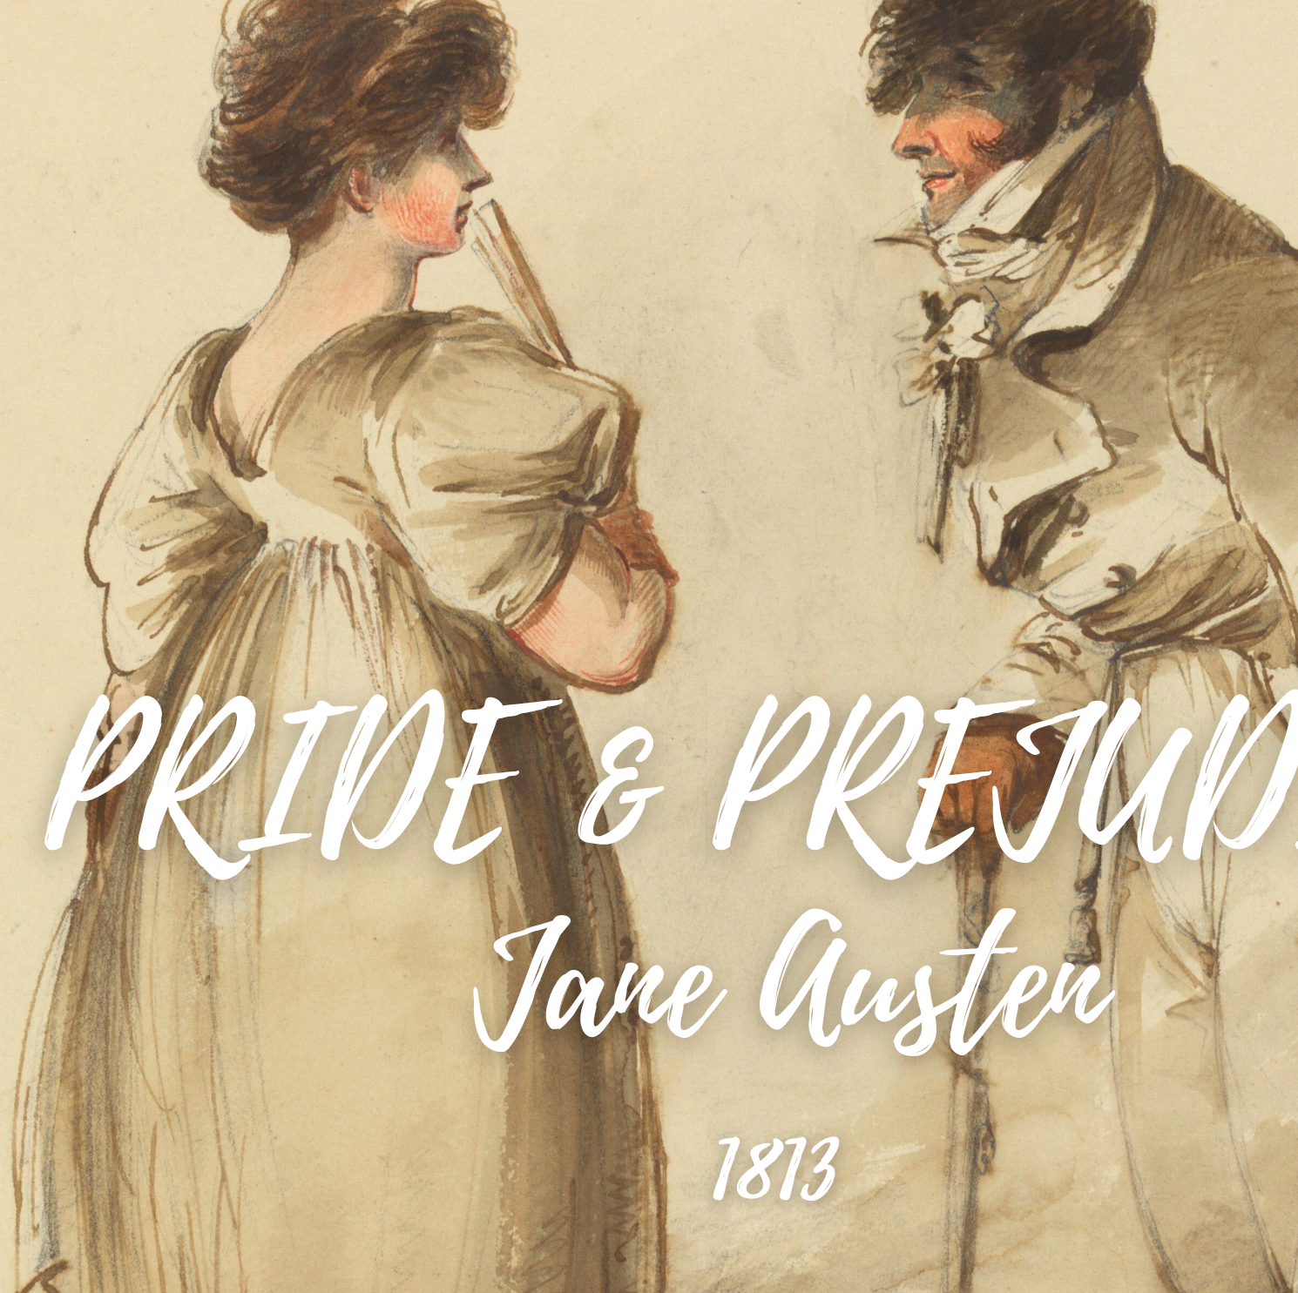
Analysing Texts using Python
Computer Science
Worksheet 1 – Handling Full Texts
Slides created by Áine Rourke. Worksheets and Code by Dr. Derek Greene (under CC-BY-NC licence)

Slide 2
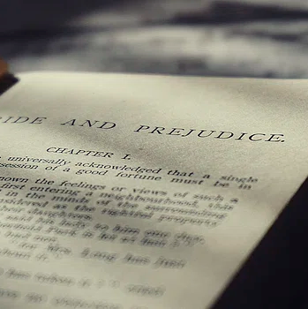
What first?
First, we need a text to work with. We will be looking at Pride and Prejudice……a classic novel!
Go to www.novelanalytics.ie in Teams
Download the file from the Cultural Analytics folder
Save it in a file on your desktop
Copy and paste the file directory to Thonny

Slide 3
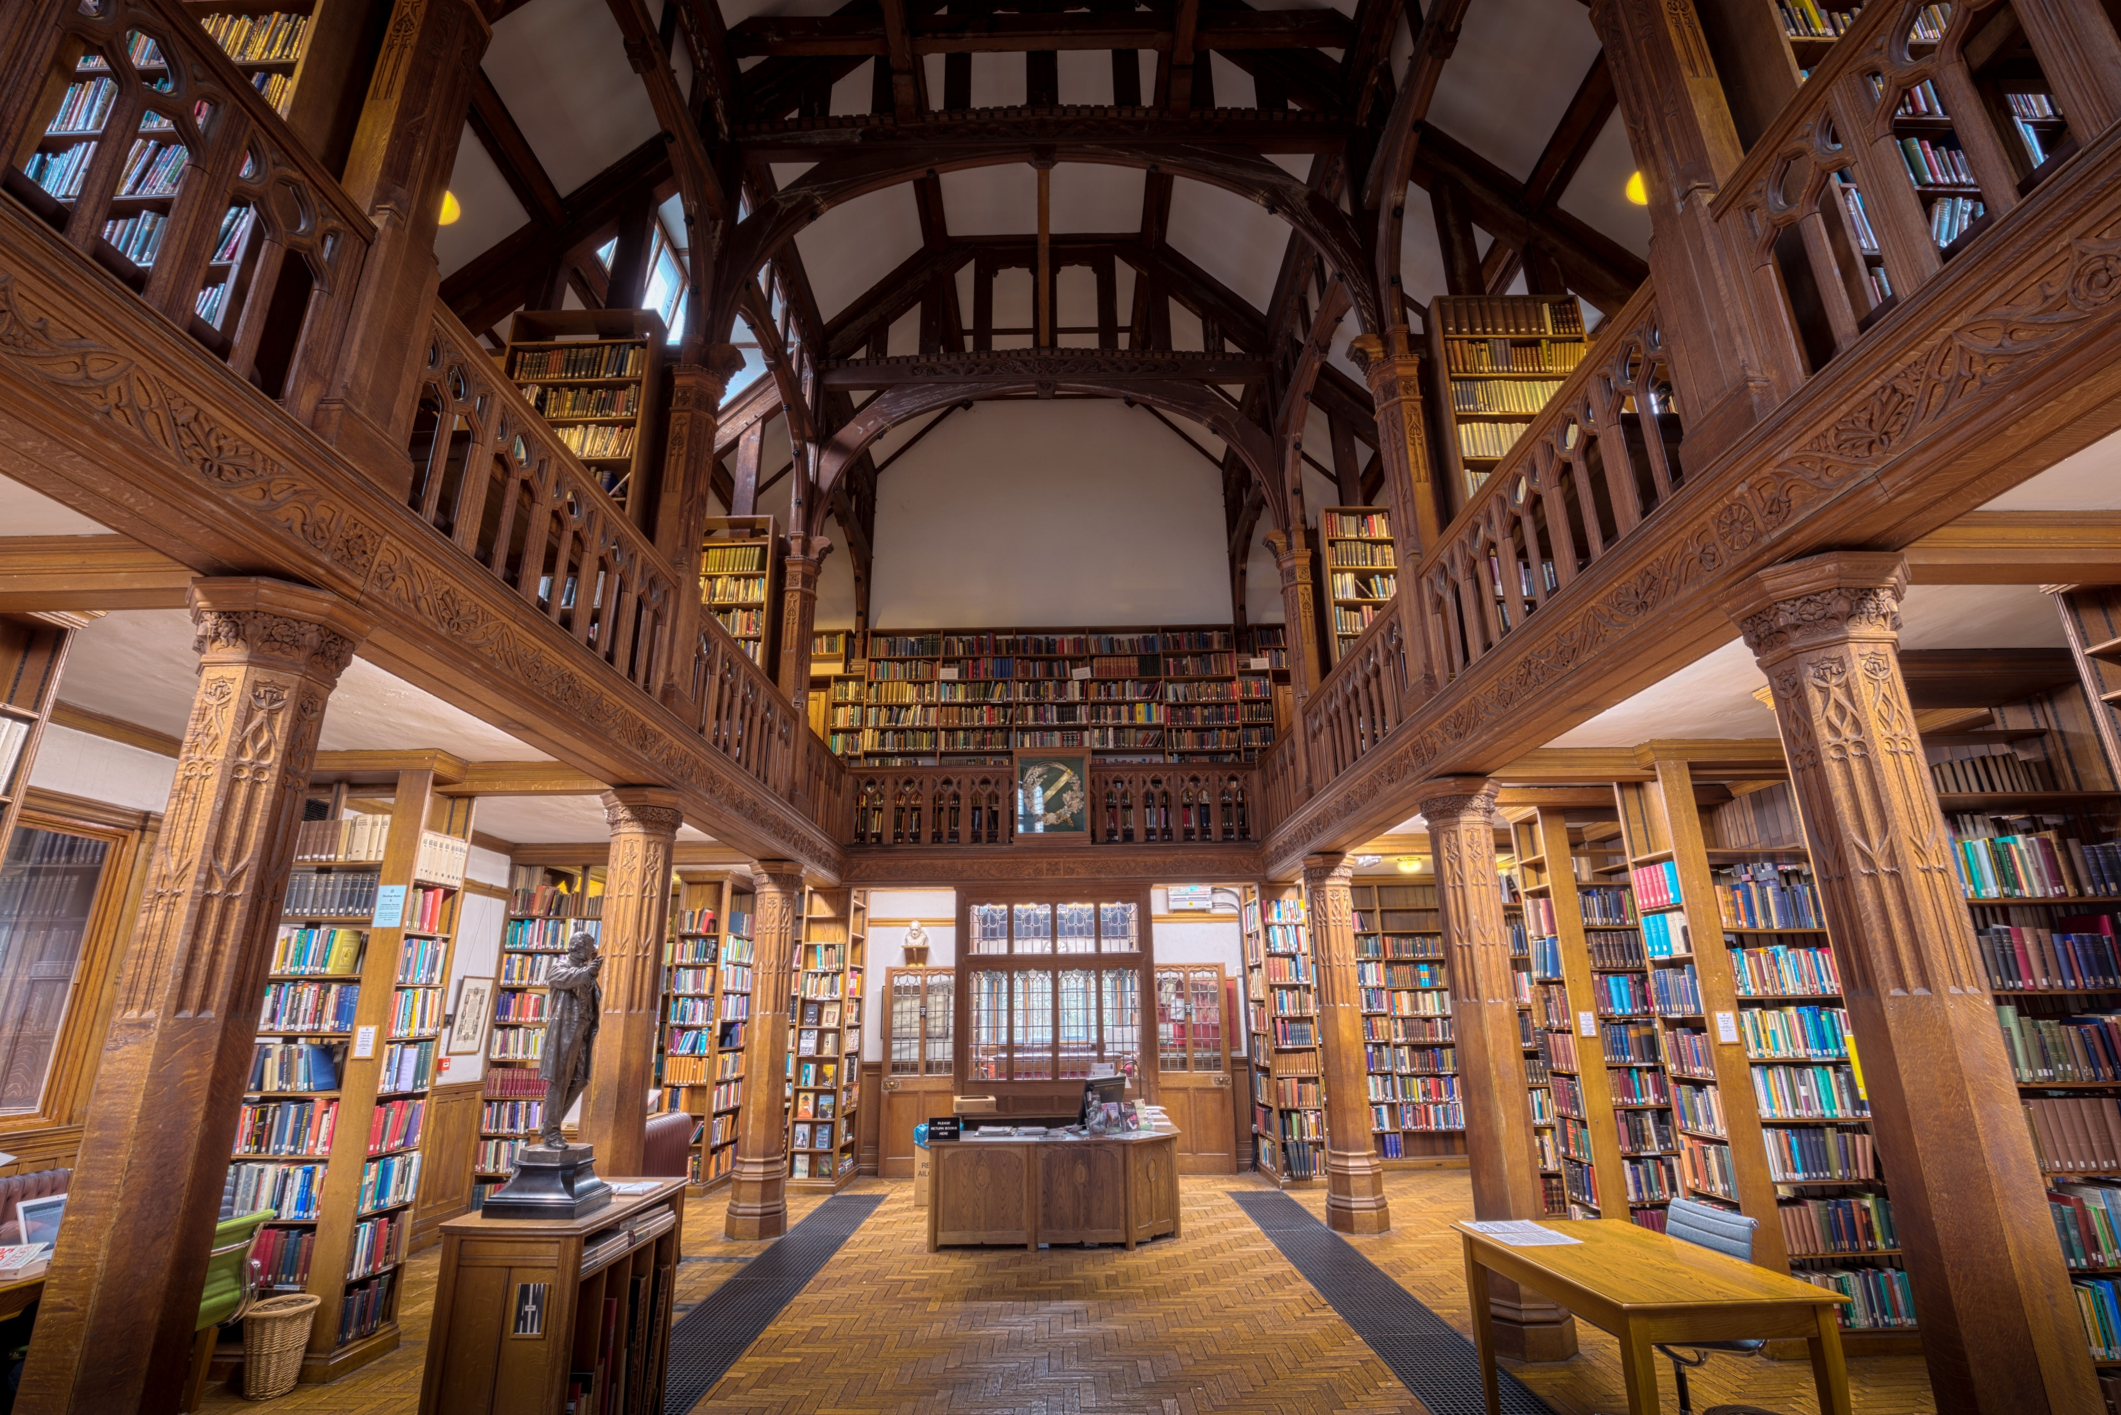
Libraries……
Libraries in python allow us to use specific tools. If the aim of this is to produce graphs what tool might be useful?
Import and libraries needed at the beginning of your programme.

Slide 4
Dir_path
Now let's point the program at the directory with the files we have downloaded
Notes:
If students use a direct location this might present issues. These can usually be solved by switching from a back-slash to a forward-slash.

Slide 5
How many lines are we dealing with?
Can you think of another way to print out the number of lines of text, do we normally use this method?
If you can, comment out this line and code your own.
Notes:
This can be done in multiple ways. This could be a nice place to try a different method.

Slide 6
Next, lets read the entire novel into a list of lines of text. Display the total number of lines in the novel.
Loading the text so we can analyse it

Slide 7
Breaking down the book
We need to know how many chapters the book has now.....how would we do this?

Slide 8
Blunt force
You can search for each "pattern" or string.....so find "Chapter 1" then try and find "Chapter 2" etc.......is this efficient though?
Is there a way with loops or even a way of making the pattern more general?
OR

Slide 9
The more elegant solution
AND
Notes:
This is a good opportunity to use the python reference sheet for in built commands like len

Slide 10
Graphing using mathplotlib
We want to initially make a plot of a line chart.......can you change the code to make this a bar chart?
What would this be a more suitable way to represent the data? (think discrete and continuous)
Change the layout....what colour would you like? Is the font big enough? Do you like the font?

Slide 11
Bonus Task……
Compare the 3 texts you have downloaded - use the same programs to analyse these.
Double Bonus Task……
Can you go to Project Gutenberg and download another book and analyse it?

Slide 12
The Novel Analytics Project materials are licensed under a Creative Commons Attribution-Non-Commercial 4.0 International License. You are free to adapt and remix the slides and worksheets provided you give credit to the creators and do not use them for commercial purposes. Permissions beyond the scope of this license may be available here.This work is licensed under a Creative Commons Attribution-NonCommercial 4.0 International License.
Slides Created by Áine Rourke. Worksheets and Code by Dr. Derek Greene. (under CC-BY-NC licence)

